Slide 1

Introduction to Language Translator
-Deepali M. Raikar

Slide 2
Translator
A translator is a programming language processor that converts a computer program from one language to another.
It takes a program written in source code and converts it into machine code. It discovers and identifies the error during translation.

Slide 3
Purpose of Translator
It translates high-level language program into a machine language program that the central processing unit (CPU) can understand. It also detects errors in the program.

Slide 4
Different Types of Translators
There are 3 different types of translators as follows:
Compiler
A compiler is a translator used to convert high-level programming language to low-level programming language.
It converts the whole program in one session and reports errors detected after the conversion.
Compiler takes time to do its work as it translates high-level code to lower-level code all at once and then saves it to memory. A compiler is processor-dependent and platform-dependent.

Slide 5
2. Interpreter
Just like a compiler,Interpreter is a translator used to convert high-level programming language to low-level programming language.
It converts the program one at a time and reports errors detected at once, while doing the conversion.
With this, it is easier to detect errors than in a compiler.
An interpreter is faster than a compiler as it immediately executes the code upon reading the code. It is often used as a debugging tool for software development as it can execute a single line of code at a time.
An interpreter is also more portable than a compiler as it is not processor-dependent, you can work between hardware architectures.

Slide 6
3. Assembler
An assembler is is a translator used to translate assembly language to machine language.
It is like a compiler for the assembly language but interactive like an interpreter.
Assembly language is difficult to understand as it is a low-level programming language. An assembler translates a low-level language, an assembly language to an even lower-level language, which is the machine code.
The machine code can be directly understood by the CPU.

Slide 7
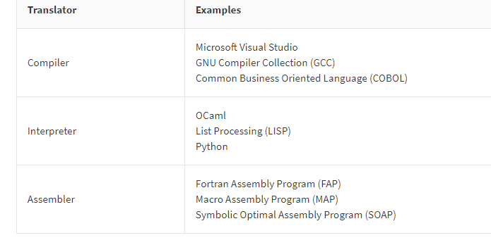
Examples of Translators

Slide 8
References.
Ecomputernotes.com
Wikipedia
Compilers-Aho,Ulman
Compiler Design-Dr. R. Venkatesh

Slide 9
THANK YOU

